Slide 1
Demon Princess
By Team Dirtbag
Team Dirtbag is:
Thomas Seggerman
Charles Cary
Ricky Marchant
Tyler Hansen

Slide 2
Demon Princess Storyline
The Princess is tired of not being rescued by her Italian Plumber Boyfriend, and has decided to break herself out, as any self-empowered female would. She looks out a window and sees a flash, and her inner power explodes open the door of the room where she was being held. She then realizes that she has the power to create Glowy-Bally-Thingy’s (GBT’s). She ventures into the next room(s), finding that the doors are locked. From there, the tutorial begins…

Slide 3

TUTORIAL SECTION
Tutorial Details:
In Start room, allow player to get used to moving.
In next room, gain power of shooting glowy ball-y thingy
In 3rd room have 2 locked doors, one made of metal, the other wood.
Knock down wooden door with power
Obtain key from Guard in Room
Key unlocks metal door from 3rd room
Room with Enemies
STAIRS
Gain
Power
Guard
w/ Key
Made of Wood
Can be Knocked Down
START

Slide 4
REMAINING SECTIONS
Remaining Levels/Details:
Multiple rooms at each level
Multiple levels of the castle
Increasing difficulty with each tier lower
Final Boss in last room
Room with Enemies
INTENSE!!!
STAIRS
STAIRS
MULTIPLE ROOMS
WITH DIFFERENT CHALLENGES
Final Room
STAIRS
Exit

Slide 5
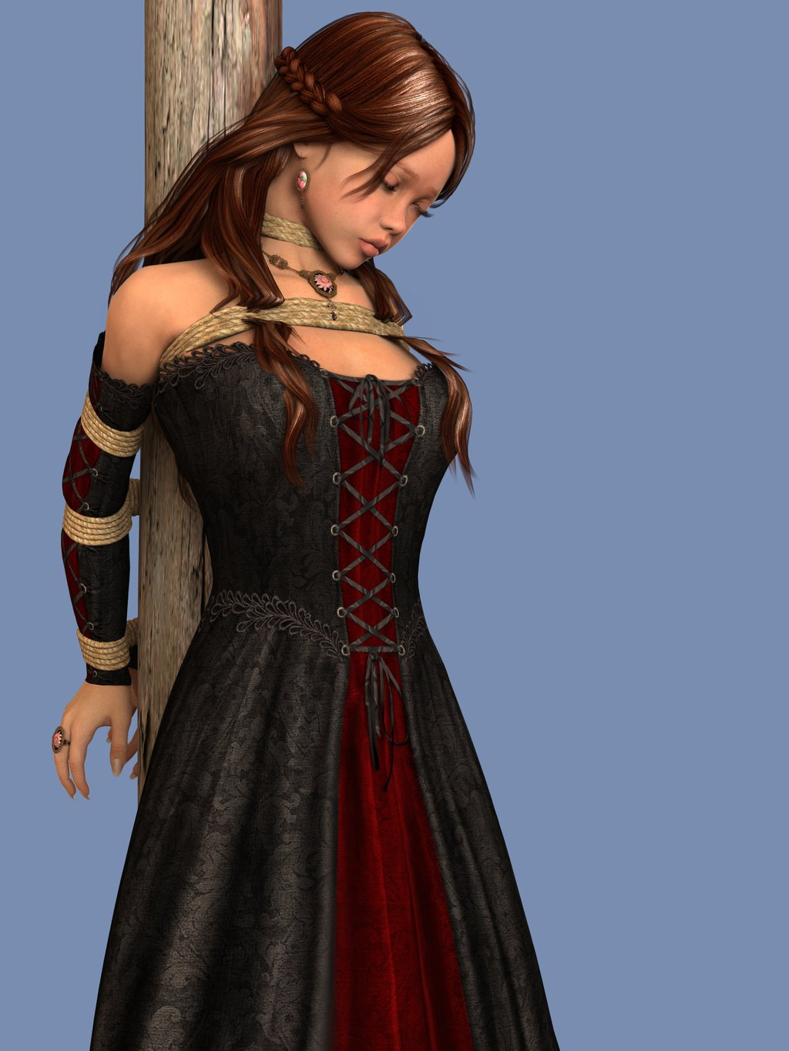

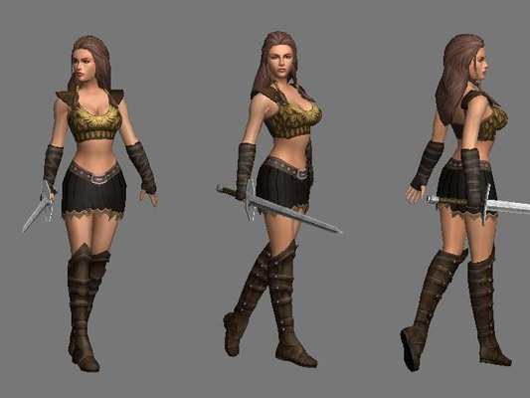
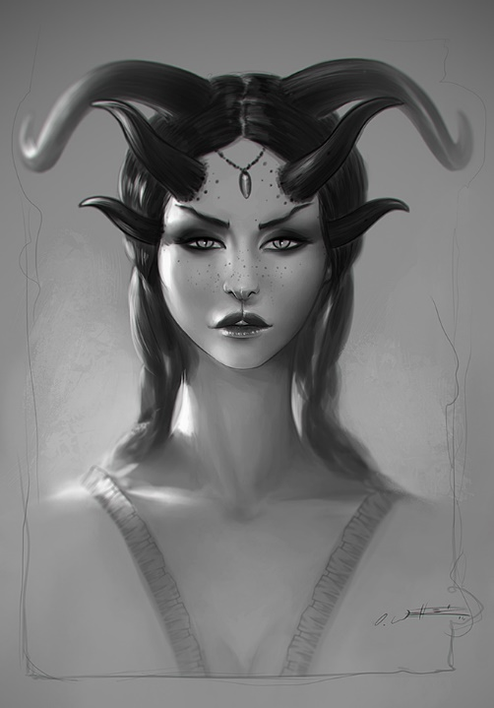
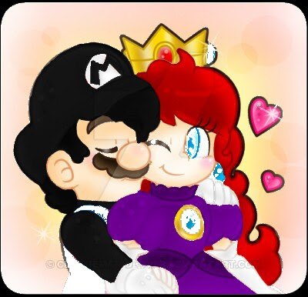

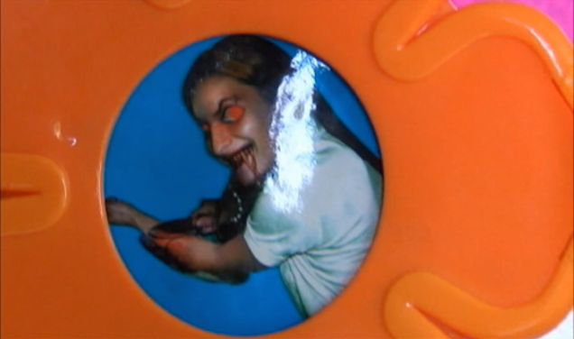



Concept Art/Collage for Princess

Slide 6
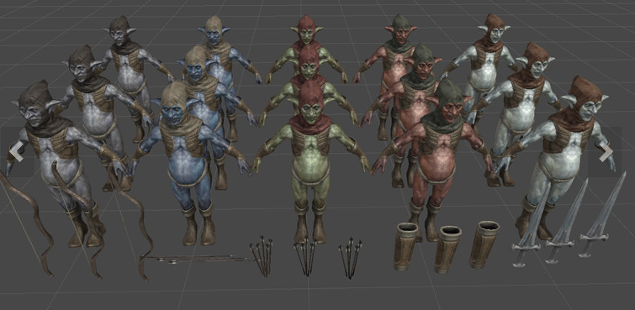
Mechanics
Switch back and forth between Demon and Human Modes?
GBT can be shot out, and returns to player
Shield creates method for defending
Goblins have different weapons
Sneaking is an option when in Human Form
Can only walk when in Demon Form
Level Design Mechanics
Traps
Spikes
Pits
Arrow Trap
Paralyzing Trap
Platforming

Slide 7


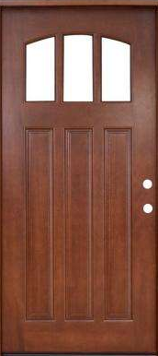

Human - Walking

Slide 8

Human - Running

Slide 9

Human - Sneaking

Slide 10

Demon - Attacking

Slide 11
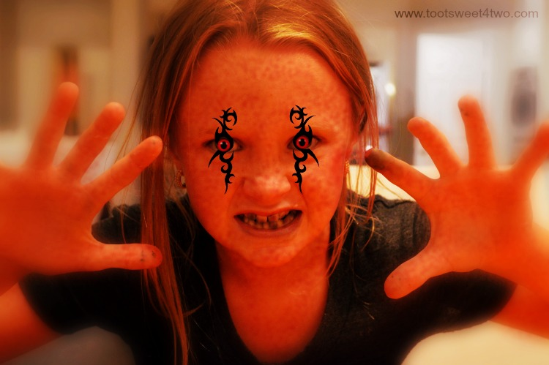
Other Game details
Leveling up will improve various abilities and stats of GBT
Remainder of game, past tutorial, is not known yet. Varying levels of necessity to sneak vs. attack will be played with, to get the best balance.
Mild platforming throughout the levels can be leveraged to create more balance as well.

Slide 12
Suggested GBT Upgrades/Abilities
Can be used as a shield
Range/distance lengthening
Size of GBT enlarged
Damage improvement
Elemental effects
Burst Shots
Radius Explosion

Slide 13
Timeline/Breakout
Prototyping
1-2 weeks – Done by May 31st
32 hours of design @ 8hrs/person
Playable demo/Alpha:
~1 week – Done by June 5th
16 hours of major polishing @ 4hrs/person
Beta:
~1 week – Done by June 9th
16 hours of other polishing @ 4hrs/person
Final Release:
Remaining time until Jun 12th
Additional Polishing will be ~5-20 hours

